Slide 1
Focusing: Orientation
Lesson 3

Slide 2
Is a kind of counseling, just developing more skill and using more tool. Focusing in moving forward
What is coaching?

Slide 3
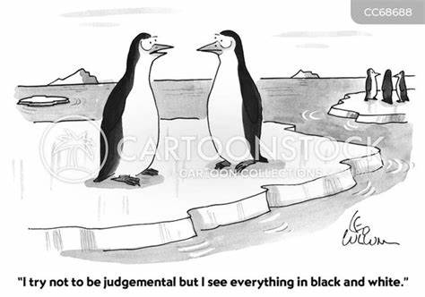
Non Judgmental Awareness
Curiosity

Slide 4
Desire for balance is a factory setting, like safety and routine
Balance

Slide 5
Focusing: (Spotlighting)
Showing up in the conversation in a way that shines a spotlight on one area of your work with the client

Slide 6
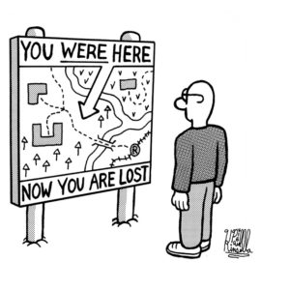
How did you get here?
Where are you now?

Slide 7
The power of the mind to create your life
We live each moment, but first…

Slide 8
MINDFULNESS
Experience the power of NOW

Slide 9
Use mindfulness to keep client focused on now
Teach mindfulness for some reason

Slide 10
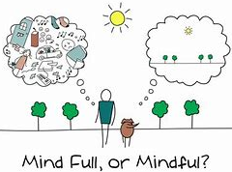
Non judgmentally and staying grounded in your present body/environment/conversation…

Slide 11
4
Box breathing
4
4
4

Slide 12
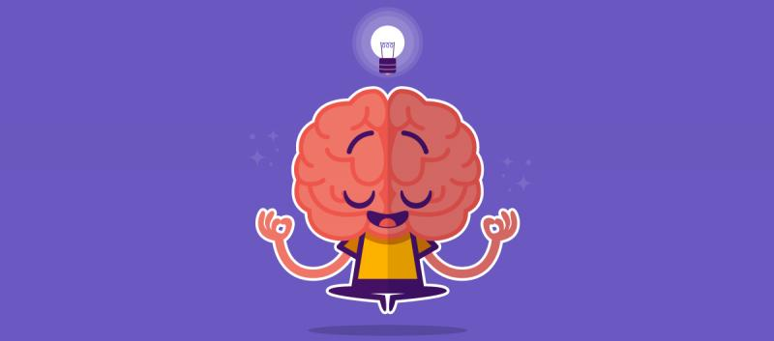
Mindfulness
exercise

Slide 13
Finding out what is wrong in these areas can point us to possible goals for the client to pursue.
12 Areas of Balance

Slide 14
When the client know that something is wrong, but not what
Values

Slide 15
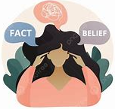
Psychological state of discomfort that occurs when someone holds conflicting beliefs, values, or attitudes
Cognitive Dissonance
People experience cognitive dissonance when their actions are not in line with their values or beliefs.

Slide 16
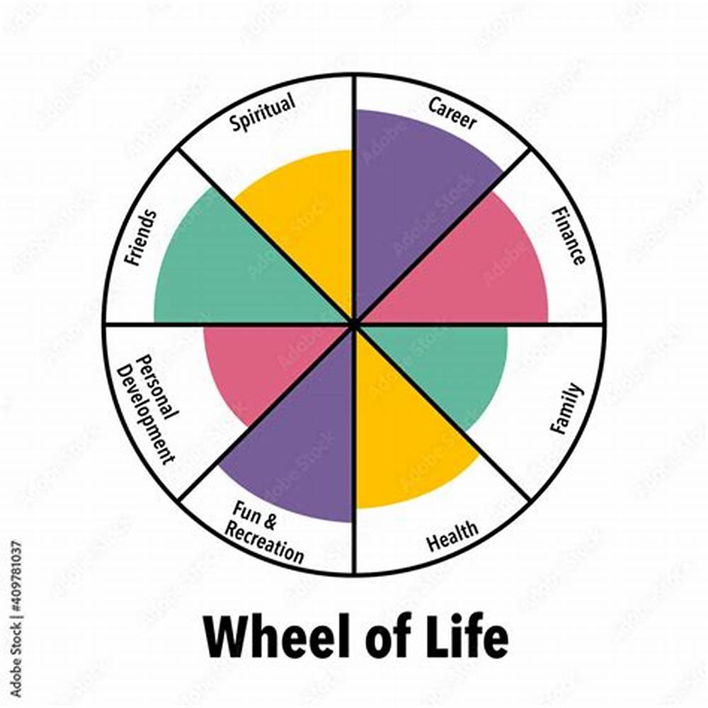
Wheel of life

Slide 17
Discovering the Ultimate Why
Level 1
What is important to you about becoming successful?
Level 2
Why is it important for you to ____________?
7 Layers deep
Level 3
Why is it important for you to ____________?
Level 4
Why is it important for you to ____________?
Level 5
Why is it important for you to ____________?
Level 6
Why is it important for you to ____________?
Level 7
Why is it important for you to ____________?

Slide 18
Meaning making and making a life
Belief / Identity
Thoughts
Emotions
Behaviors
Outcome / Results

Slide 19
Meaning making and making a life
Belief / Identity
Thoughts
Emotions
Behaviors
Outcome / Results
Outcomes / Results
Behaviors
Emotions
Thoughts
Belief / Identity

